Slide 1
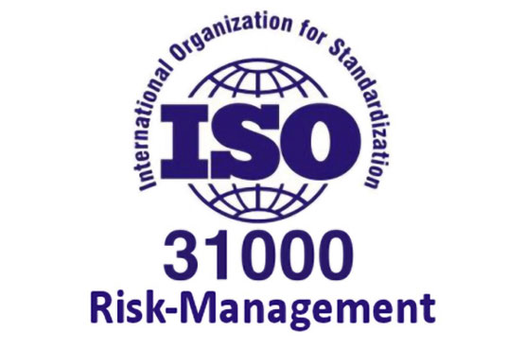
A Discussion of The ISO 31000 Risk Management Standard

Slide 2
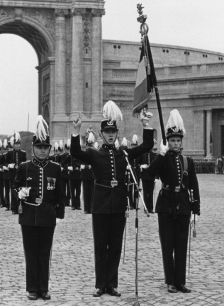
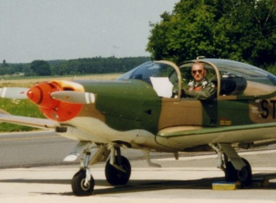
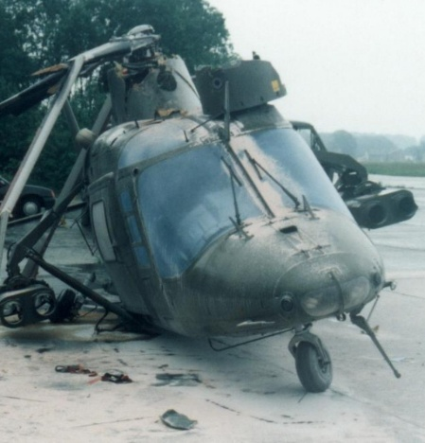
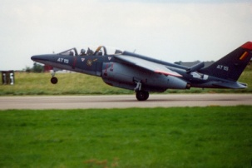
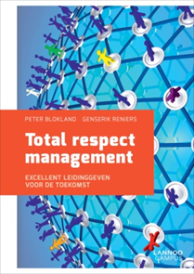
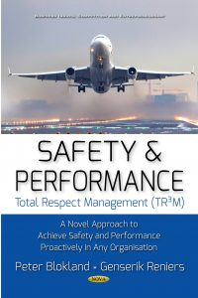
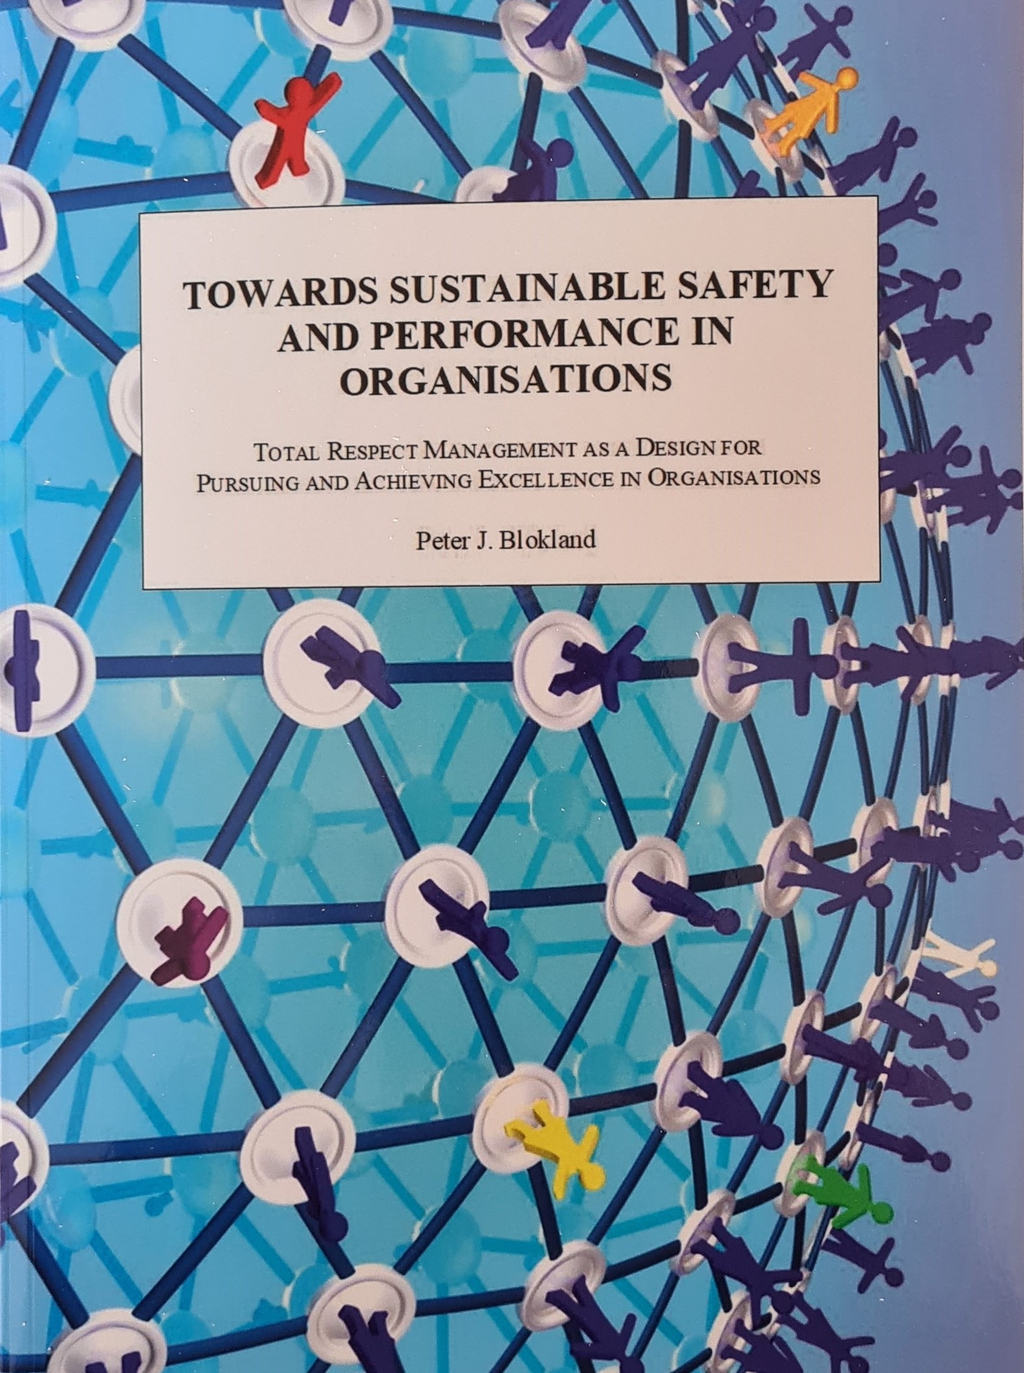
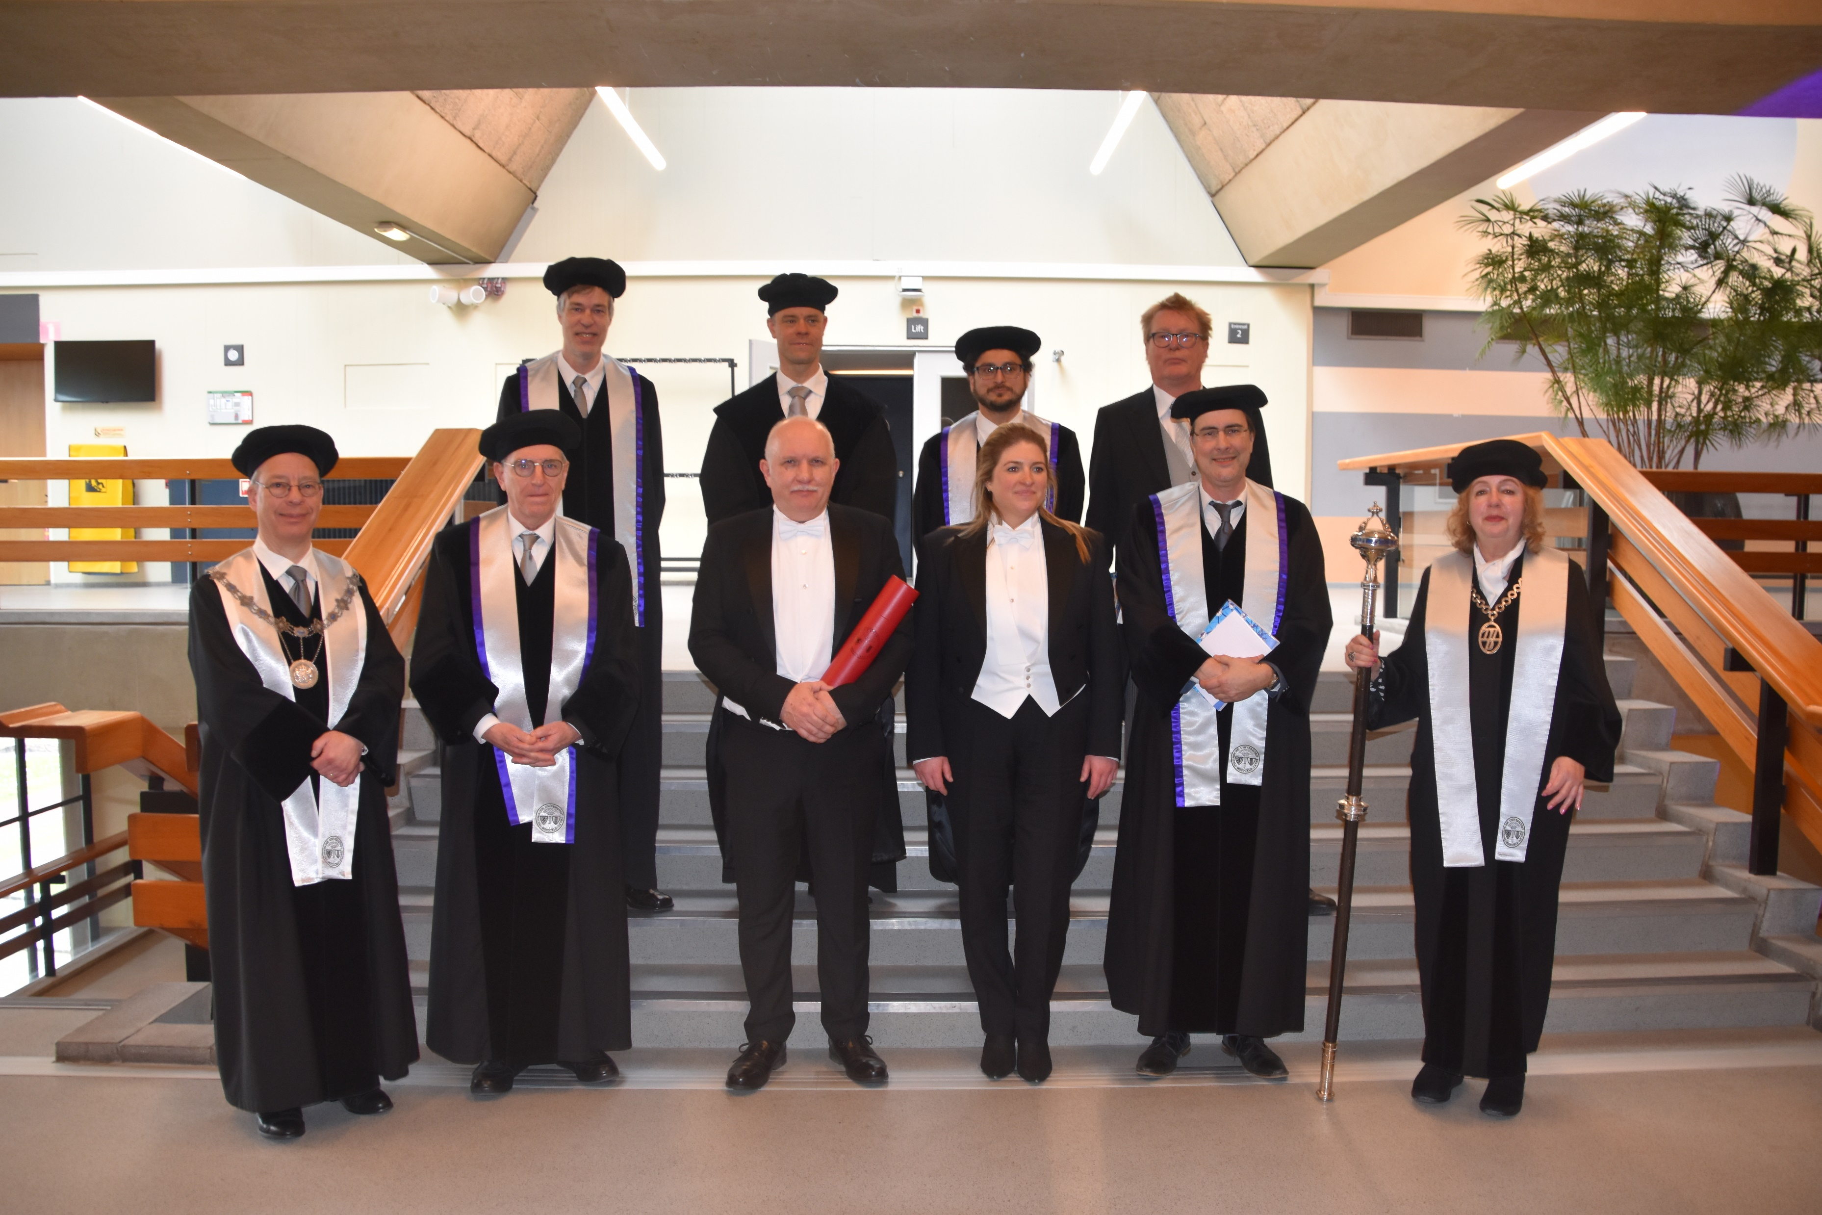

Slide 3
ISO 31000 – Risk Management Guidelines
Principles
23 Pages
15 Pages
Process
Framework

Slide 4
Risk: Effect of Uncertainty on Objectives
Uncertainty: State, even Partial, of Deficiency of Information Related to Understanding or Knowledge
(ISO 31073 : 2022)
Objectives: Result to be Achieved
(ISO 31073 : 2022)
Effect: Deviation from the Expected
Can be Positive, Negative or Both

Slide 5
Risk ≈ FIRE
RISK
FIRE
YOU NEED 3 ELEMENTS
TO HAVE FIRE
YOU NEED 3 ELEMENTS
TO HAVE RISK
OXYGEN = UNCERTAINTY
HEAT = EFFECT
FUEL = OBJECTIVES

Slide 6
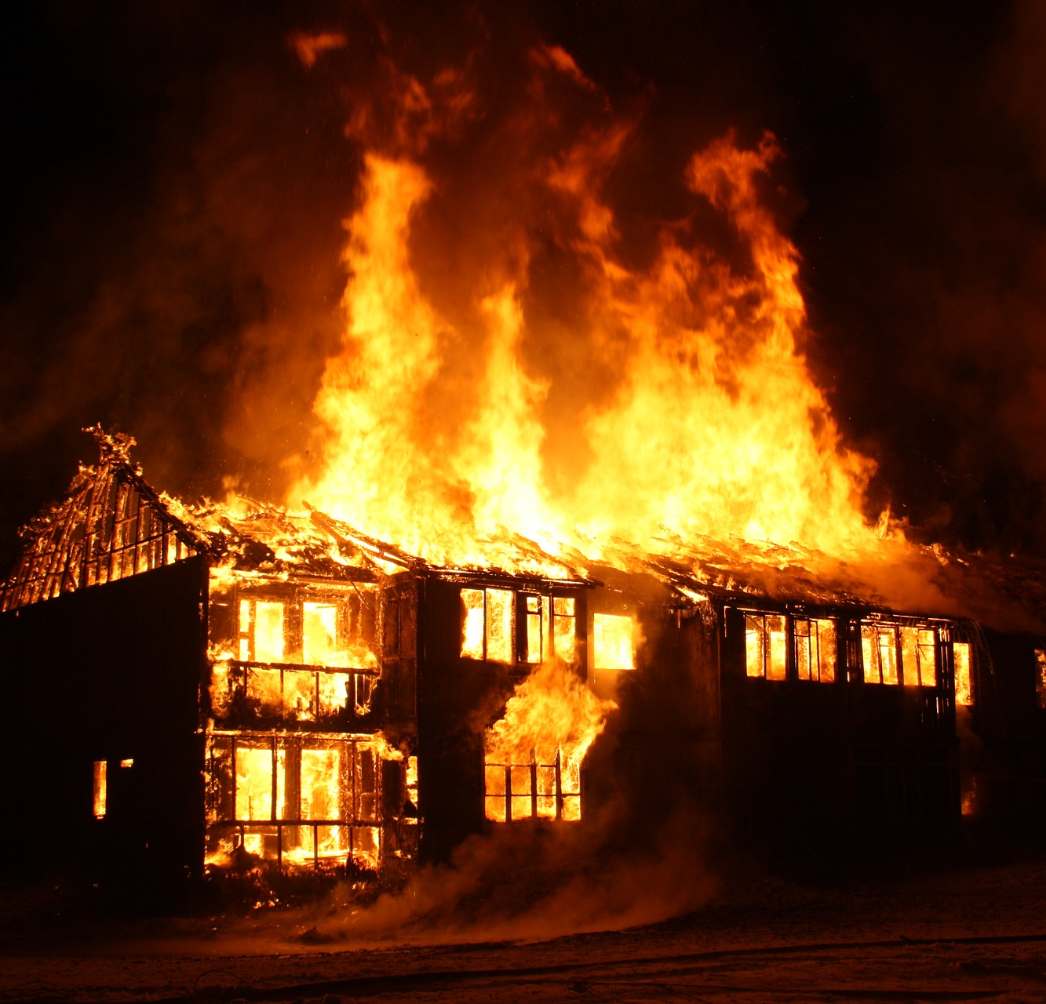
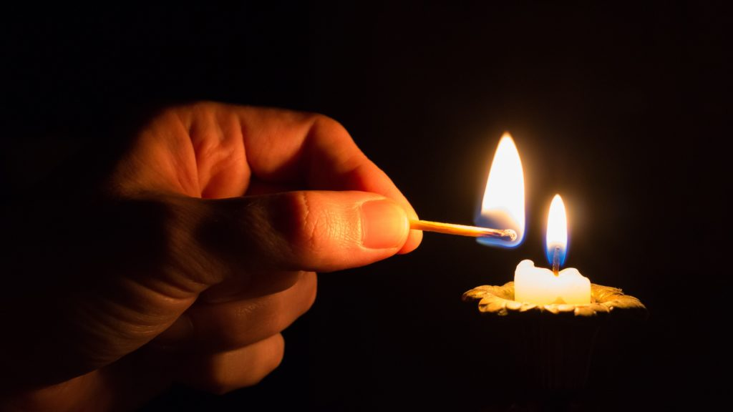

Slide 7
Risk Management
Coordinated Activities
to Direct and Control
an Organization
with regard to Risk

Slide 8
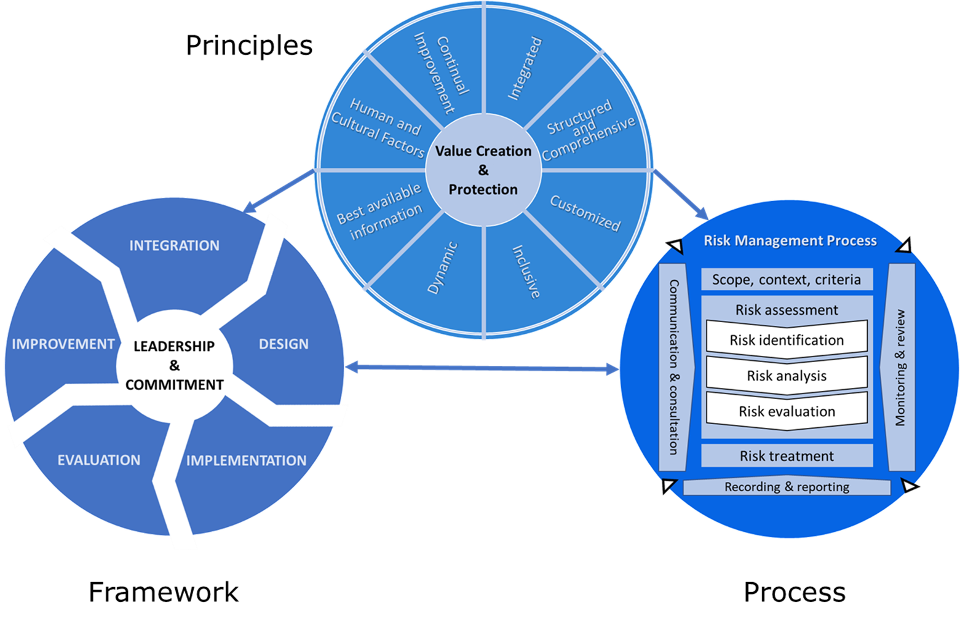
ISO 31000

Slide 9
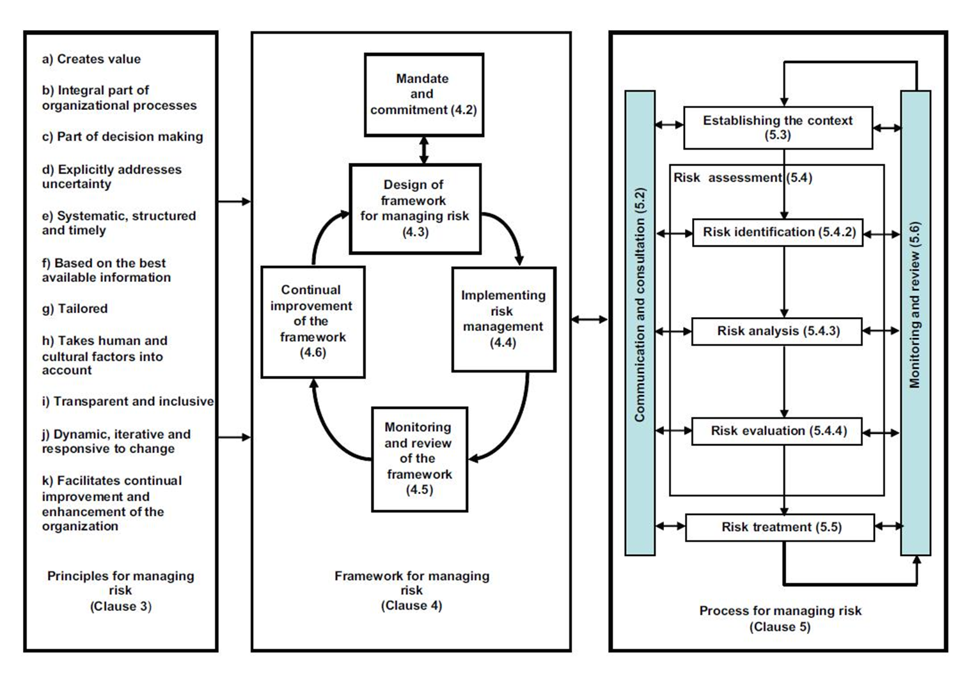
ISO 31000 - 2009

Slide 10
ISO 31000

Slide 11
ISO 31000
Vocabulary

Slide 12
ISO 31000 – Vocabulary (2009 – 2018)
TERMS and DEFINITIONS
2.1 RISK
2.2 RISK MANAGEMENT
2.3 RISK MANAGEMENT FRAMEWORK
2.4 RISK MANAGEMENT POLICY
2.5 RISK ATTITUDE
2.6 RISK MANAGEMENT PLAN
2.7 RISK OWNER
2.8 RISK MANAGEMENT PROCESS
2.9 ESTABLISHING THE CONTEXT
2.10 EXTERNAL CONTEXT
2.11 INTERNAL CONTEXT
2.12 COMMUNICATION AND CONSULTATION
2.13 STAKEHOLDER
2.14 RISK ASSESSMENT
2.15 RISK IDENTIFICATION
2.16 RISK SOURCE
2.17 EVENT
2.18 CONSEQUENCE
2.19 LIKELIHOOD
2.20 RISK PROFILE
2.21 RISK ANALYSIS
2.22 RISK CRITERIA
2.23 LEVEL OF RISK
2.24 RISK EVALUATION
2.25 RISK TREATMENT
2.26 CONTROL
2.27 RESIDUAL RISK
2.28 MONITORING
2.29 REVIEW

Slide 13
Levels of Perspective
Action Mode
VISION
Generative
MENTAL MODELS
Reflective
LEVERAGE INCREASES
SYSTEMIC STRUCTURES
Creative
PATTERNS
Adaptive
EVENTS
Reactive

Slide 15
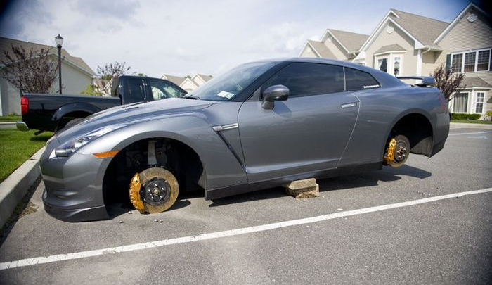

Slide 18
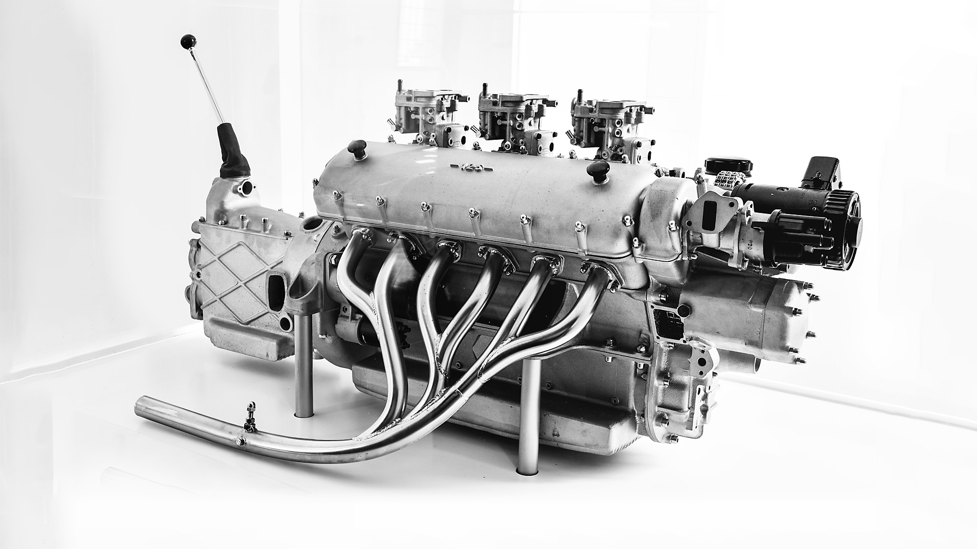

Slide 19
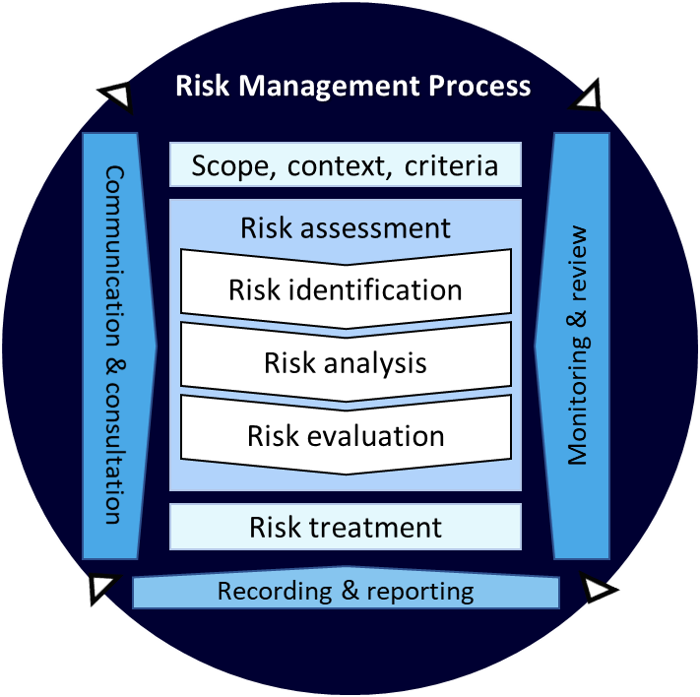
ISO 31000 - Process
Establishing the context
Risk Assessment
Risk identification
Communication and consultation
Monitoring and review
Risk analysis
Risk evaluation
Risk treatment

Slide 20
Time for Questions and Discussion

